Slide 1
The University of Rochester
Fellowships Office
An Introduction for Transfer Students
Presented by Juliet Sullivan

Slide 2
What’s a fellowship?
A competitive opportunity funded by sources outside the university. There are different kinds of awards: opportunities (such as research), money for your studies, or experiences very much like a job (such as teaching abroad).

Slide 3
A rough guide
Fellowship
Scholarship
Grant
Financial Aid
Special Opportunities

Slide 4
So what exactly do you do?

Slide 5
The Fellowships Office
Helps students locate opportunities
Helps students develop strategies for applying
Coaches students throughout the writing process
Through our website, social media, and information session
Including strategies for finding recommenders, which activities to highlight
Review and discuss drafts with students. We want you to put your best foot forward.

Slide 6
- Gregory Hernandez, Transfer student (‘2020 AME) and Fulbright Scholar
The fellowship application process was crucial to my development as a researcher; it helped me tremendously when it came to writing my graduate school applications, my masters thesis, and research proposals! Efficiently and strongly describing my development as an engineer and scientist was the greatest challenge I faced while writing my applications. Also, trying to fit my life story into a single page for some of my award applications was very difficult!

Slide 7
What do fellowships offer?
Funds for your education
Research experience
Work experience
Mentoring/contacts
Travel
Stipend
Prestige

Slide 8
How hard is it to win a fellowship?
It’s easier than you think
It’s harder than you think
UR students—including transfer students—win fellowships all the time.
These are competitive opportunities, and the applications take careful crafting

Slide 9
What will I learn from the process?
Articulating your goals
Telling your story
Cultivating mentors
Interview practice
Fellowships require you to describe your future plans. This is not easy and takes practice.
Connecting the dots between experiences—often very important for transfer students.
This is a great chance to connect with faculty (and in many cases, others at UR)
Many fellowships require that we interview our applicants. This is a safe place to practice with people who want you to succeed.

Slide 10
Some transfer student success stories

Slide 11
Jaye Tran (’19 ANT) in Jordan on the Critical Language Scholarship

Slide 12
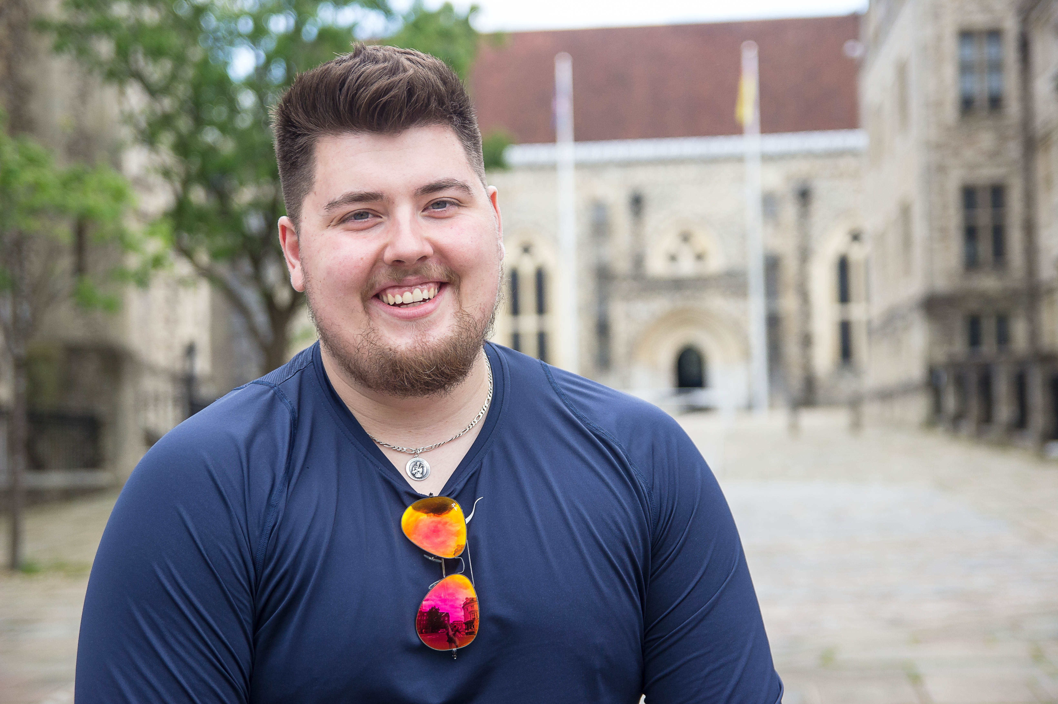
Greg Hernandez, Fulbright to the UK (’20 AME)

Slide 13
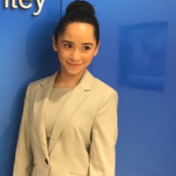
Cindy Molina (‘18 HIS) Fulbright to Mexico

Slide 14
Thanks for inviting us!
Any questions? Stop by our office at 4-209B Dewey Hall
E-mail us at fellowships@rochester
Call us at 585-276-5869
Visit our website: www.rochester.edu/college/studentfellowships/

Slide 15
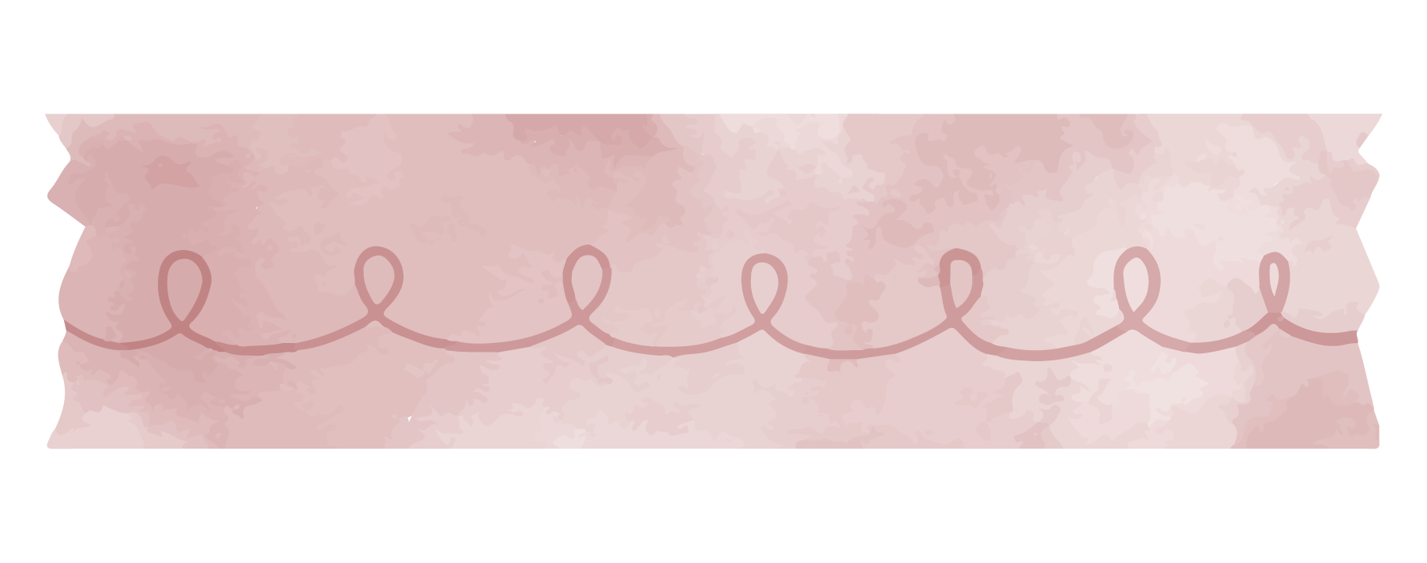
Follow us on social media
Facebook: /www.facebook.com/URFellowships/
Instagram: @urfellowshipsoffice

