Slide 1
Buy Pitch: Wix.com
NASDAQ: WIX

Slide 2
Company Overview: Qualitative
Wix is a website-building platform that serves over 150 million people in roughly 190 countries and is headquartered in Tel Aviv, Israel. Wix provides individuals and small- to medium-sized businesses a website platform interface, which can be used to create innovative and unique websites to better connect with the target market.

Slide 3
Company Overview: Products & Subsidiaries
Free website creation with drag-and-drop interface
Includes ads
Prohibits commercial activity
Premium website creation in HTML5 ($13-$39/Month)
Logo Maker
Wix App Market
Wix Hotels & Restaurants
DeviantArt

Slide 4
Industry Overview
Monthly subscriber model is king
Streaming services
Communications
Tech Development

Slide 5
Company Overview: Financials
Market Cap $6.4B
FY2018 revenue $603.7M
P/E 81.7x
EV/Rev 10.64x

Slide 6
Investment Thesis
Wix.com provides solid growth prospects, driven by (a) ARPU and premium subscriber increases, (b) diversity of product offerings, and (c) geopolitical opportunities

Slide 7
Positive User Feedback & Usage Statistics
30.7% of web developers plan to use Wix more this year than last year
34.1% plan to use Wix more in future years than this year
Only 12.0% plan to use Wix less in the future
Source: SunTrust Humphrey Robinson

Slide 8
ARPU Progression
ARPU is average revenue per user
17% net growth in premium subscriptions in FY2018
Sustained ARPU growth in subscriber services every year since 2013 IPO
Source: Zacks Research; Thomson Reuters
Notes:
Daler

Slide 9
Increasing Mobility
Expansion of Wix App generated M-commerce revenue increase of 32.7% in FY2018
Overall M-commerce sales projected to grow 29.9% y/y from FY2018 to 19.
Source: Zacks Research; eMarketer
Notes:
Daler

Slide 10
DeviantArt
DeviantArt provides Wix with advertising revenue originating from 1.6B monthly page views, and a large social media presence:
2.1M Facebook followers
1.1M Twitter followers
369K Instagram followers
Source: DeviantArt; Google Analytics

Slide 11
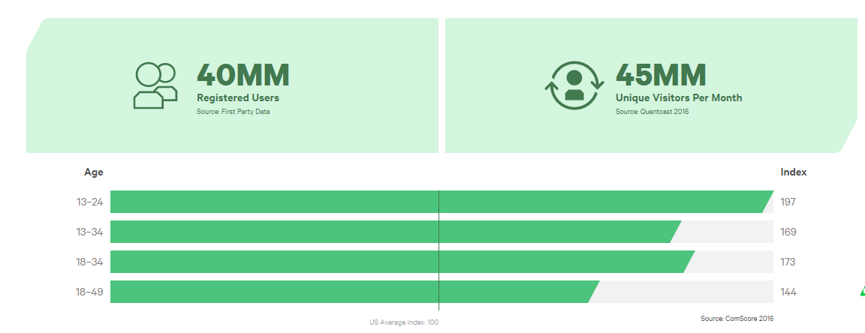
DeviantArt (cont.)

Slide 12
Geopolitical Opportunities: Asia & Elsewhere
Partnership with NTT Japan furthers exposure to premium business customers in Asia Pacific region.
Digital commerce initiatives in Sub-Saharan Africa gives access to new markets
Source: JMP Securities; MasterCard Foundation

Slide 13
Potential Weakness: Small Cap
$6.4B Market Cap: stock is thinly traded
However, beta is only 0.88
Smaller companies generally have higher default risk
But WIX is equity heavy (93% of capitalization)
Rapidly growing balance sheet reduces risk of liquidity problems & credit crunches

Slide 14
Potential Threat: Lack of Presence in East Asia
Asia-Pacific is the fastest growing E-Commerce arena
Wix does not compete directly with E-Commerce behemoths (Amazon, Alibaba, etc.). However, direct competitors Shopify and BookingSuite are more invested in East Asia.
Source: Zacks Research; eMarketer

Slide 15
Quantitative Analysis: DCF
DCF
Assumptions:
2.4% Perpetuity Growth
4.1% Market Risk Premium
1.735% Risk Free Rate (10-yr US Treasury)

Slide 16
Quantitative Analysis: Public Comps
Comps

Slide 17
Our Recommendation
Buy $1,950 of WIX at $125.87/share
PT $166/share at 32.41% margin; 2-yr growth horizon
Stop loss $100/share

