Slide 1
Merck & Co. (MRK)
Stock Pitch
Healthcare Industry
Meliora Finance and Investment Group

Slide 2
Company Overview
Global Healthcare Company
Consumers
Success
Prescription medicines
Vaccines
Biologic therapies
Animal health products
Drug wholesalers/retailers
Hospitals/Government agencies
Managed healthcare providers
Veterinarians/animal producers
Keytruda
Approvals
Acquisitions
Keytruda
Recent acquisitions

Slide 3
Industry Overview
US health sector
Global pharmaceuticals
High Barriers
Negotiating Power
Strong growth 4.3-5.5%
Forecast period 5.2-5.6%
Value of $4.82B (2023)
Forecasted to reach $1.42B by 2022
US (37.6%), Asia-Pacific (27.3%), Europe (24.9%), Middle East (1.6%), Other (8.6%)
FDA standards
Quality/loyalty
Extensive capital
R&D
Monopoly w/ patents
Generic companies undercutting prices
Notes:
Forecast to have value of $4.82 billion in 2023 -> increase of 31.1% (2018)
Global pharmaceuticals market’s healthy growth
Forecasted to reach $1.42 billion by 2022 -> almost $300 million increase (2017)
US (37.6%), Asia-Pacific (27.3%), Europe (24.9%), Middle East (1.6%), Other (8.6%)
Look at portion in us vs. international especially for the key drugs

Slide 4
Macrotrends
Inflation
Growing population
Brexit
Low levels
Decreased medical expenditures
Higher demand for healthcare
68% of US households own a pet
Possible supply shortage of medicines within UK
Increased dependence on US market

Slide 5
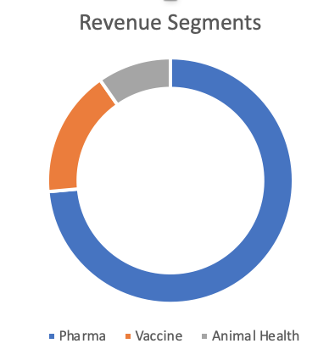
Financials
$225.75B
Market Cap
$42.29B
$9.36B
Revenue
Net Income

Slide 6
Investment Thesis
Merck & Co. is a stable investment based upon its key revenue growth in emerging business lines and recent acquisitions to add to its leading treatments in an overall global, diversified portfolio.

Slide 7
Strengths
R&D
Financial Performance
Consumer Confidence
Ebola Vaccine, RECARBRIO
Extensive oncology research
$42.3B and 23.3% ROE (2018)
Global Sales
Brand name
Range of products at least satisfactory level
Notes:
Strong R&D
Ebola Vaccine - under review, declared global health emergency by WHO
RECARBRIO bacterial treatment - cleared by FDA, under review by EU
Extensive oncology research
Strong Financial Performance
$42.3 billion last year, 40.1 billion in 2017 & 23.3% ROE last year, 6.9% in 2017
Global Sales
Brand name and consumer confidence
Large range of products at a least satisfactory level

Slide 8
Weaknesses
Key Products
Financial Performance
Firm-Specific Risk
Reliance on key products
Januvia, Janumet, Keytruda, Bridion, Gardisil/Gardisil 9
Patent expirations
Increased Costs
Generic product competition
Profitability ratio below industry average
Inability to penetrate into developed markets
Inability to penetrate into developed markets
China comprises 5% of sales
Notes:
Significance Reliance on Key Products
Januvia, Janumet, Keytruda, Bridion, Gardisil/Gardisil 9
Patent Expirations, increased costs, generic product competition
Profitability Ratio below industry average (68% vs. 78%)
Inability to penetrate into developed markets
China comprises 5% of sales

Slide 9
Opportunities
Acquisitions
Product Approvals
New Profits
Peleton Therapeutics
Antellip Cooperation
Immune Design
Tilos Therapeutics
Keytruda
Lynparza
Online platform
Decreasing cost of transportation
Notes:
Acquisitions
Peloton Therapeutics - oncology research
Antelliq Cooperation - vaccine research
Immune Design - cancer/vaccine development
Tilos Therapeutics - possible combination with Keytruda
Product Approvals
Investment into an online platform
New sales channel
Decreasing cost of transportation

Slide 10
Threats
Animal Pharma
Competition
Austerity/Global
Seasonal
High sensitivity to disease epidemics
Lower demand for animal products
Generic products
Cutting prices
Government pricing practices
Recession
Hospitals/government pay less
Subject to event shocks
Notes:
Animal Pharma industry under threat
High sensitivity to disease epidemics w/in animals
Intense Competition
Generic products
Austerity measures and global transitions
Government pricing practices
Recession -> hospitals/government to pay less
Product demand seasonal
Subject to event shocks

Slide 11
DCF

Slide 12
Comparable Analysis

Slide 13
Recommendation
Buy
Target $154.11
Stop Loss $74.71
Allocate 8%

