Slide 1
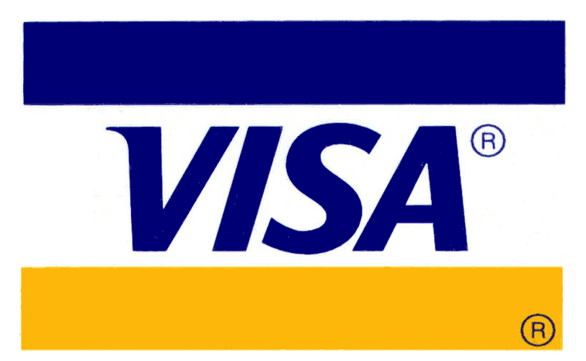
NYSE: V

Slide 2
VISA Overview
Visa Inc., an American multinational financial services corp, headquartered in CA
Facilitates electronic funds transfers throughout the world
Does not issue cards, extend credit or nor earn interests on consumers
Provides Visa-branded payment products that they use to offer credit, debit, prepaid and cash access-program to their customers

Slide 3
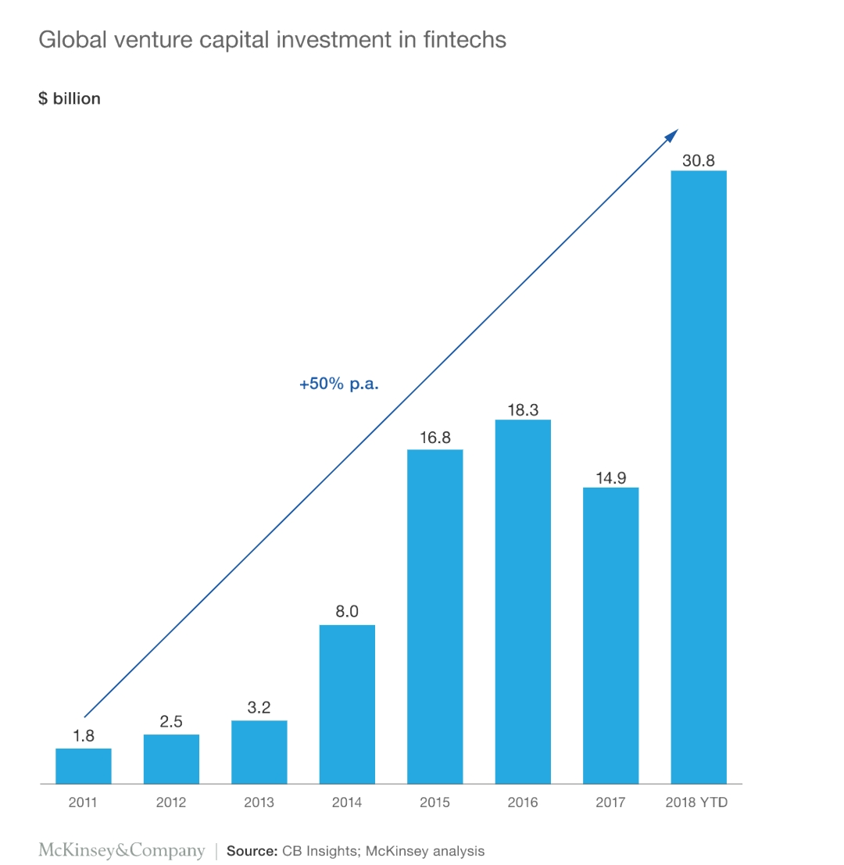
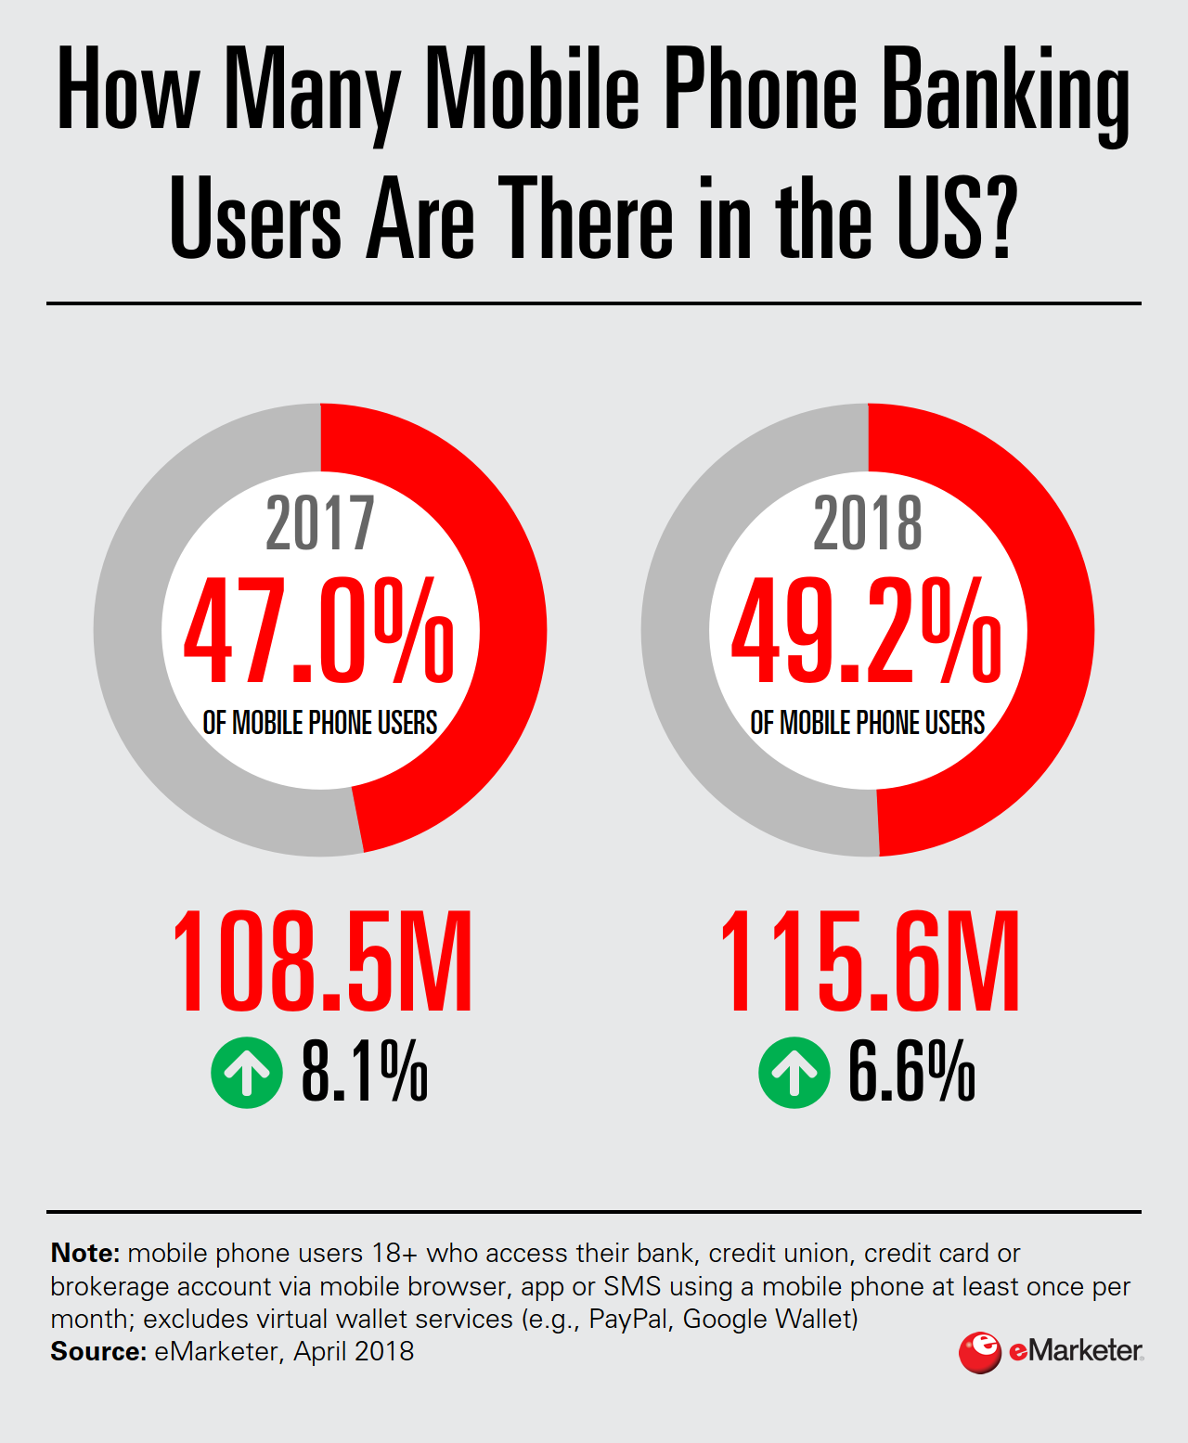
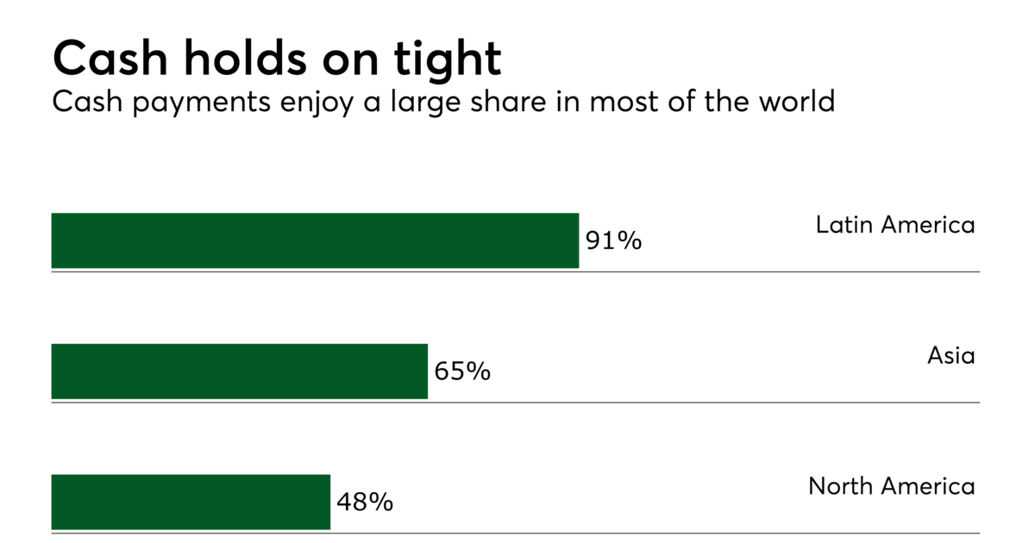
Financials Sector Trend
Cashless payment globally
Digital Banking / E-wallet
Fintech acquisitions
Notes:
According to reports by McKinsey & Co Panorama:
FinTech Acquisition Deal Activity has hit an all-time high this year with a whopping $117 billion in fintech deals closed - and building on the trends that Evan referred to, this record-breaking year is a result of cashless payments soaring in popularity.
Furthermore, almost 80% of financial institutions have entered into fintech partnerships.
The average deal size is also growing, especially in Asia, where it is almost twice as large as the global average -> this result is mainly due to the number of mega deals. Specifically in Asia, Chinese ecosystems have scaled and innovated faster than their Western counterparts.

Slide 6
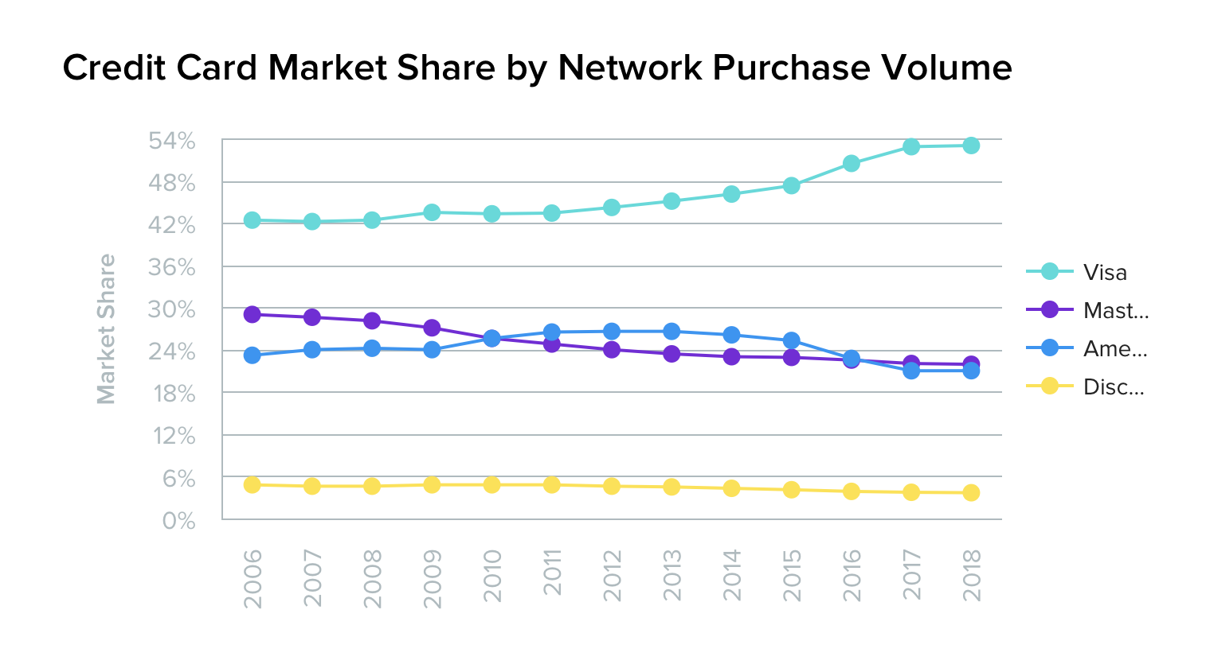
VISA Financials
Market Cap: 34.17 bil
Revenue 2018: 20.61 bil
Net Income 2018: 10.3 bill

Slide 7
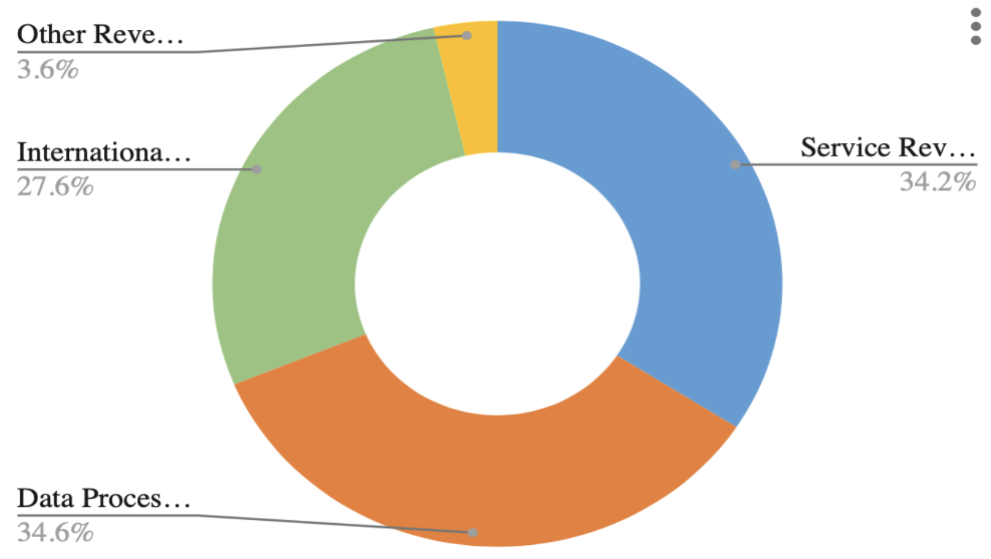

Slide 8
VISA’s Outlook
Electronic payments displacing cash in many global markets.
Opportunities still exist: annual cash purchases are $21 trillion and nearly 2 billion adults are without payment accounts
Visa aims to fast-track acceptance and bring the security and convenience of electronic and digital payments globally

Slide 9
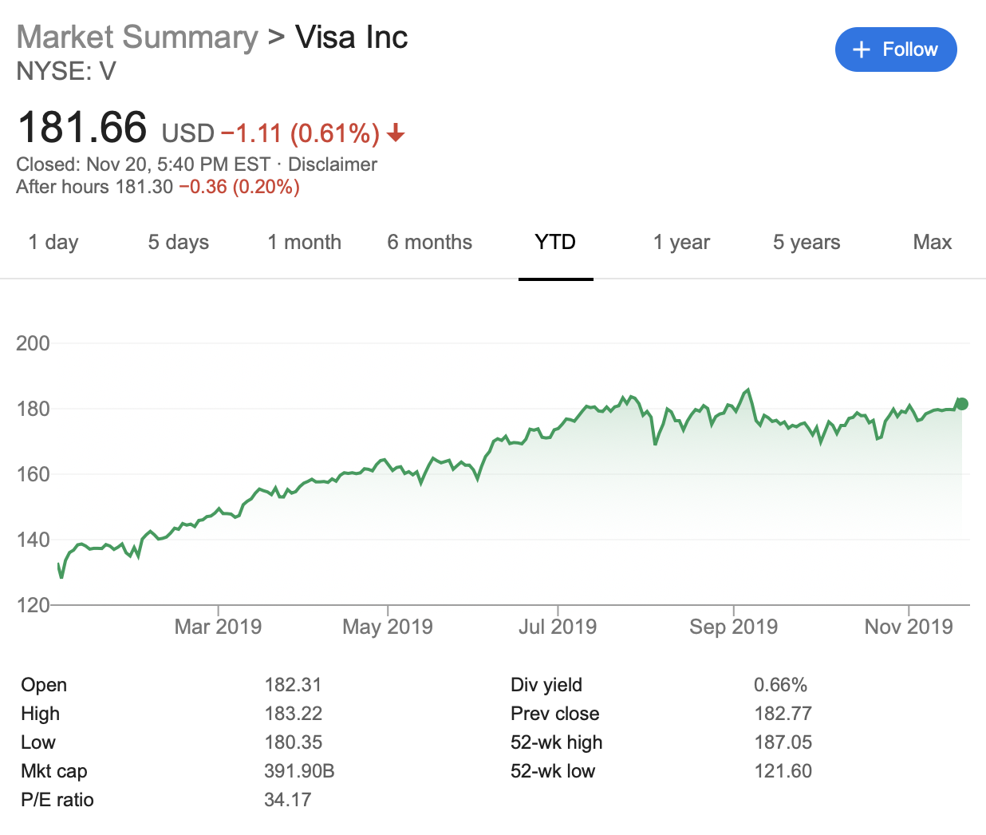
Stock Performance YTD

Slide 10
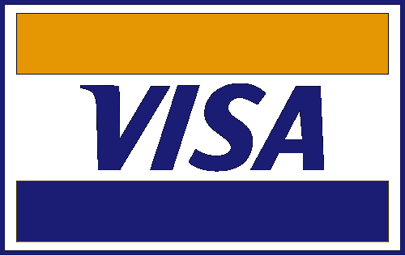
Investment thesis
We believe VISA Inc. possessed huge potential in strong core business (deep clients/partnerships), continued growth in digital commerce, global expansion of Visa products.

Slide 11
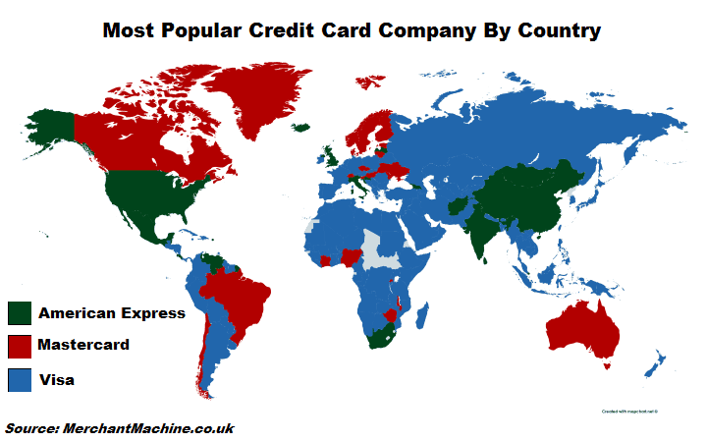
SWOT - STRENGTH
Strong distribution network
High level of customer satisfaction
Automation
Product innovation
Superb performance in new markets
Notes:
First of all, VISA has a strong distribution network that allows it to reach a majority of its potential market.
The company, with its dedicated customer relationship department, has been able to achieve a high level of customer satisfaction.
All the activities of VISA are automated, thereby bringing consistency of quality to Visa products. It has helped the company to scale up and down based on the demand of the market.
VISA has a successful track record to develop new innovative products.
Visa has built expertise in entering new markets and making a success of them. The expansion has helped the company to build a new revenue stream and diversify the economic cycle risk in the markets it operates in.

Slide 12
SWOT - WEAKNESS
Limited success outside core business
Need more investment in new technologies
Organization structure is only compatible with the present business model
Notes:
Even though Visa is one of the leading organizations in its industry, it has faced challenges in moving to other product segments.
Although VISA spends a good amount on research and development, it fails to compete with its competitors in the industry with respect to innovation.
Organization structure is only compatible with the present business model, thus limiting expansion in adjacent product segments.
What technologies specifically?

Slide 13
SWOT - OPPORTUNITY
Global trend towards cashless payments
Regional Collaborations:
Internal Programs:
Acquisitions (2019):
Europe
China
Risk Management
“Instant Deposit” (SMBs)
TSP Program
Japan
Expansion of Visa B2B Connect (32 new countries, 62 in total)
Tokenize Transactions
Latin America
Australia
Payment Gateway
Notes:
Intro:
According to McKinsey & Co Panorama:
A prominent trend of the winners in fintech is that they are primarily region-targeted, rather than starting off as global ventures (which is similar to traditional retail banking). An increasing number of fintechs are realizing the benefits of combining strengths in partnership models - to expand on a region-targeting basis
Global trend towards cashless payments - Remember, Visa makes money through transaction frequency and transaction volume
Partnerships/Collaborations:
Regions:
Europe - Revolut: Revolut is Europe’s leading fintech company and it offers sought after services such as currency exchange, budgeting and person-to-person (P2P) payments. By leveraging Visa’s global network, Revolut will be able to offer their services to new market regions. This will significantly increase the volume of transactions on the Visa network
Latin America - Mercado Libre: e-commerce company
Australia - Westpac: three banks that are part of the Westpac Group
Japan - Line: a social media platform with hopes to expand into retail
China - Lakala: a financial services platform - the largest off-line e-Payment service company in China
Programs within:
Intuit’s QuickBooks - “Instant Deposit” -> which works through Visa Direct, will allow SMBs to access funds faster
(Visa Ready) TSP Program - Tokenization collaborative effort (collaboration) to extend Visa’s platform into an ever-growing array of devices that take non-traditional means of payment: e.g cars, homes, etc. VISA is looking to make all transactions significantly easier and more secure. Participating companies:
Global: FitPay, Gemalto, Giesecke & Devrient (G + D), Infosys, Inside Secure, Rambus
Asia Pacific/India: Mahindra Comviva, PayCraft
Central Europe, Middle East & Africa: Digiseq, FOO, Pri-Num, Seglan
Latin America: HST, Prosa, VeriTran, YellowPepper
Expansion of Visa B2B Connect network - a fast, secure and more efficient network, designed specifically to overcome obstacles in the cross-border corporate payments space. Infosys, leader in digital services and consulting) is integrating with this network- access for their participating financial institutions.
VISA Acquisitions:
Verifi - Verifii is a platform that provides global electronic payment and risk management solutions for card-not-present merchants =>chargeback and dispute resolution capabilities, solving disputes faster.
Bell ID - Bell ID develops chip lifecycle management software.
Payworks - Payworks provides cloud-based payment gateway technology for the POS => Visa will bring Payworks’ cloud-based solution for in-store payment processing together with its CyberSource digital payment management platform to create a fully integrated payment acceptance solution for merchants and acquirers =>**** unified payment experience whether their customers are paying in-store, in-app or online
Rambus - To tokenise transactions:
take advantage of secure payment solutions achieved by tokenization technology to reach more retailers, financial institutions and transport operators.
Also enable Visa’s tokenization efforts to reach 28 new markets from the Rambus Channel

Slide 14
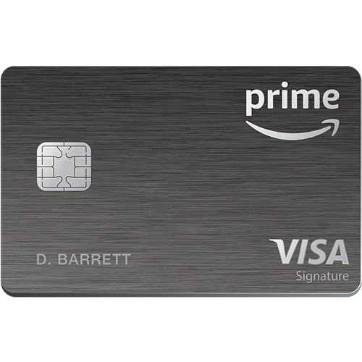
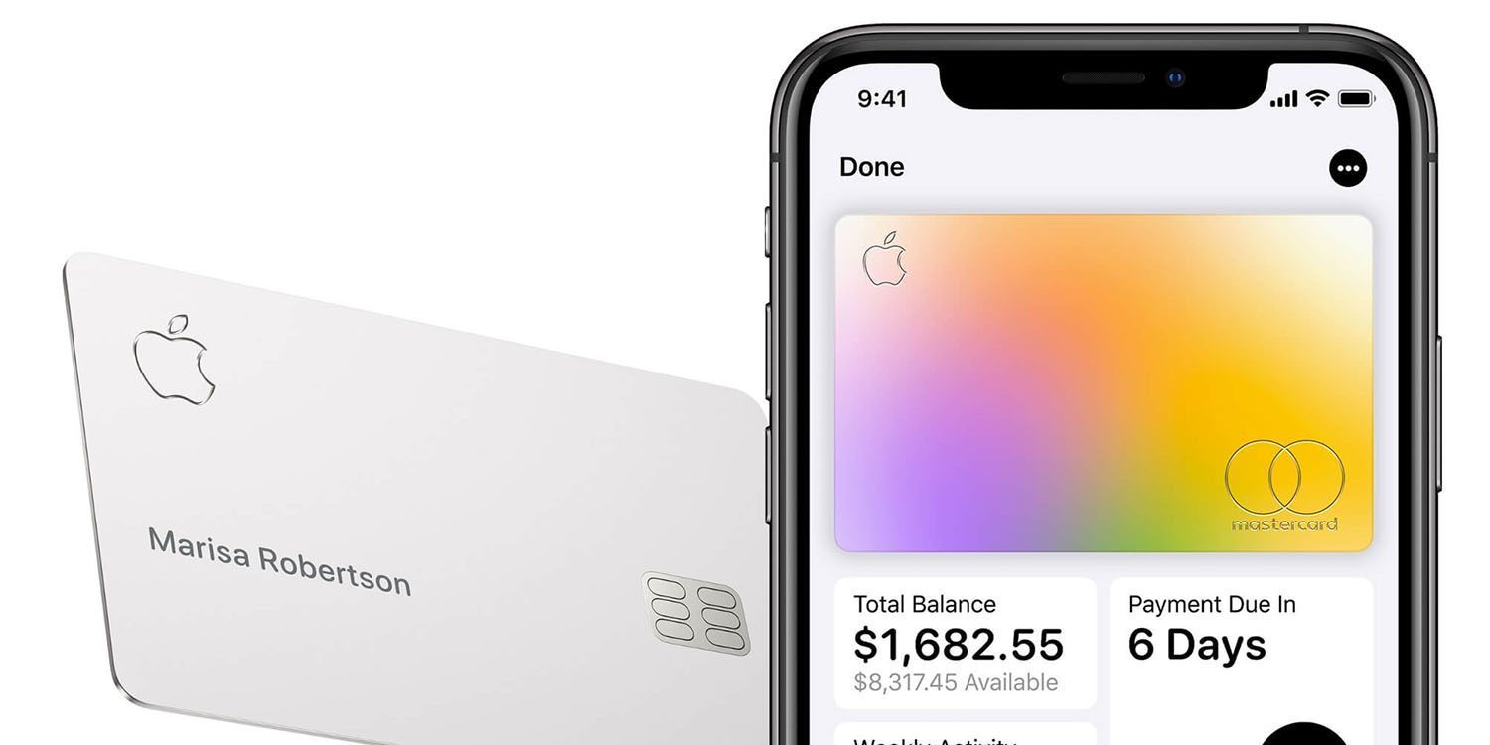
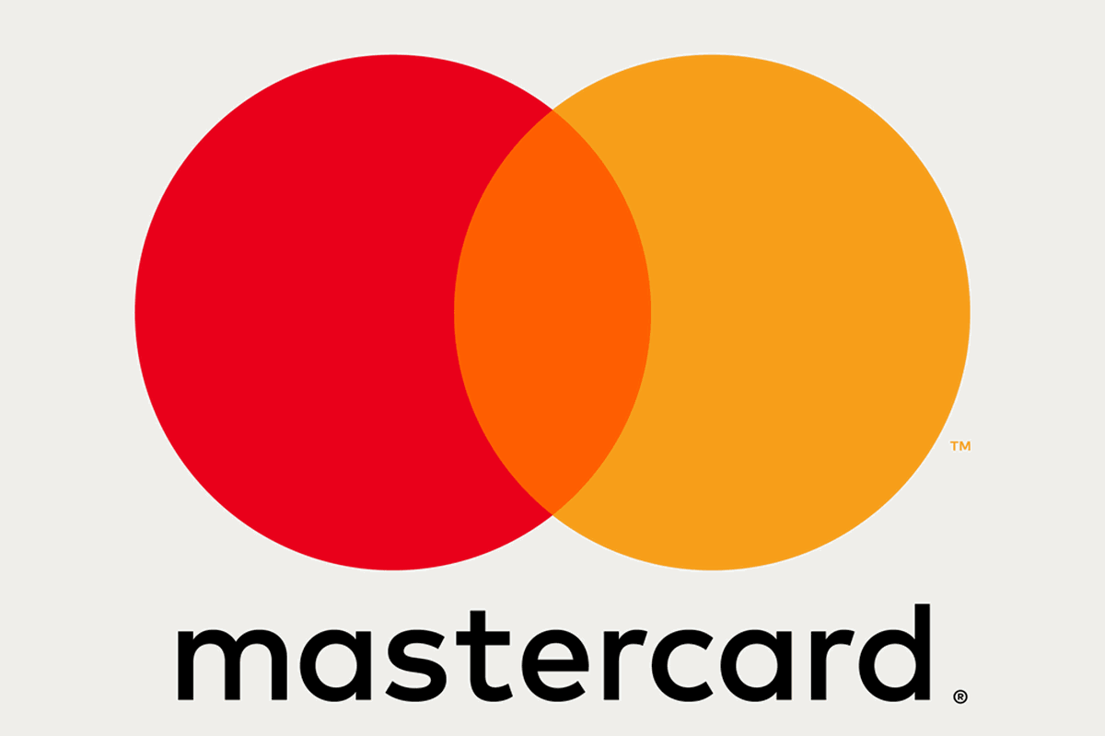
SWOT -
Raising its fees too much
Malware & fraud
Always a threat but security is increasing
Economic slowdown can hurt consumer spending

Slide 15
COMPS

Slide 16
DCF

Slide 17
Major Valuation Assumptions
Revenue Growth Rate:
Base case: 11.4%
Stress case: 9.2%
Sky blue case: 14.5%
Terminal Value EV/EBITDA: 29x
Interest expense ratio: 3.8% (historical ratio)

Slide 18
Analyst Sentiment - STRONG BUY

Slide 19
Recommendation - BUY
Price Target: $ 218 ( 23% margin )
Stop Loss: $ 140
Proposed Allocation: 5%

